Slide 1
EXPLORATORY DATA ANALYSIS FOR BANK LOAN WORKSHOP
Agenda
Data Reading and Cleaning
Data Analysis according to Deposit Status according Camping Results
Reporting and Recommendations
Present by GROUP – 2
Khin Yandar Hlaing
Thiri Whar Whar Lwin

Slide 2
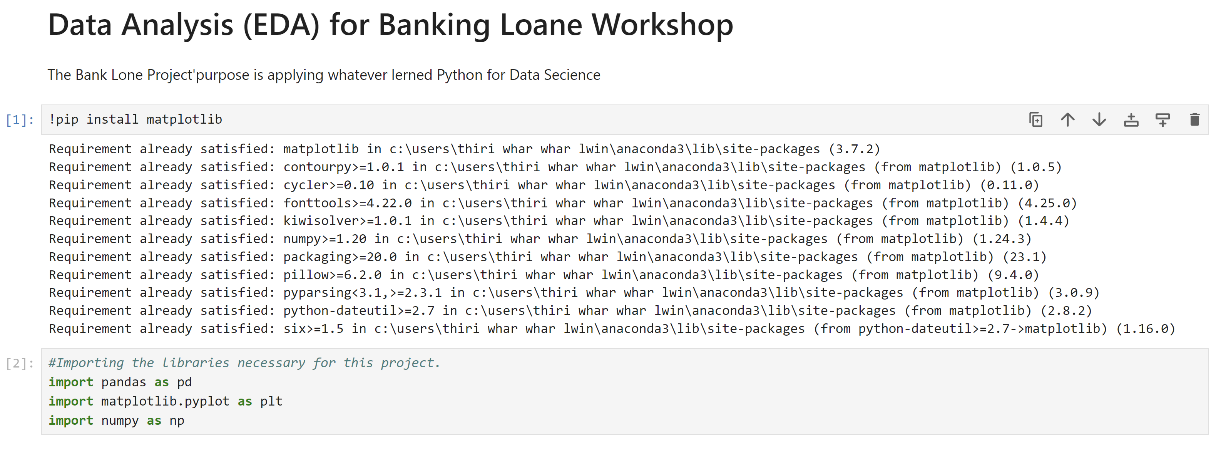
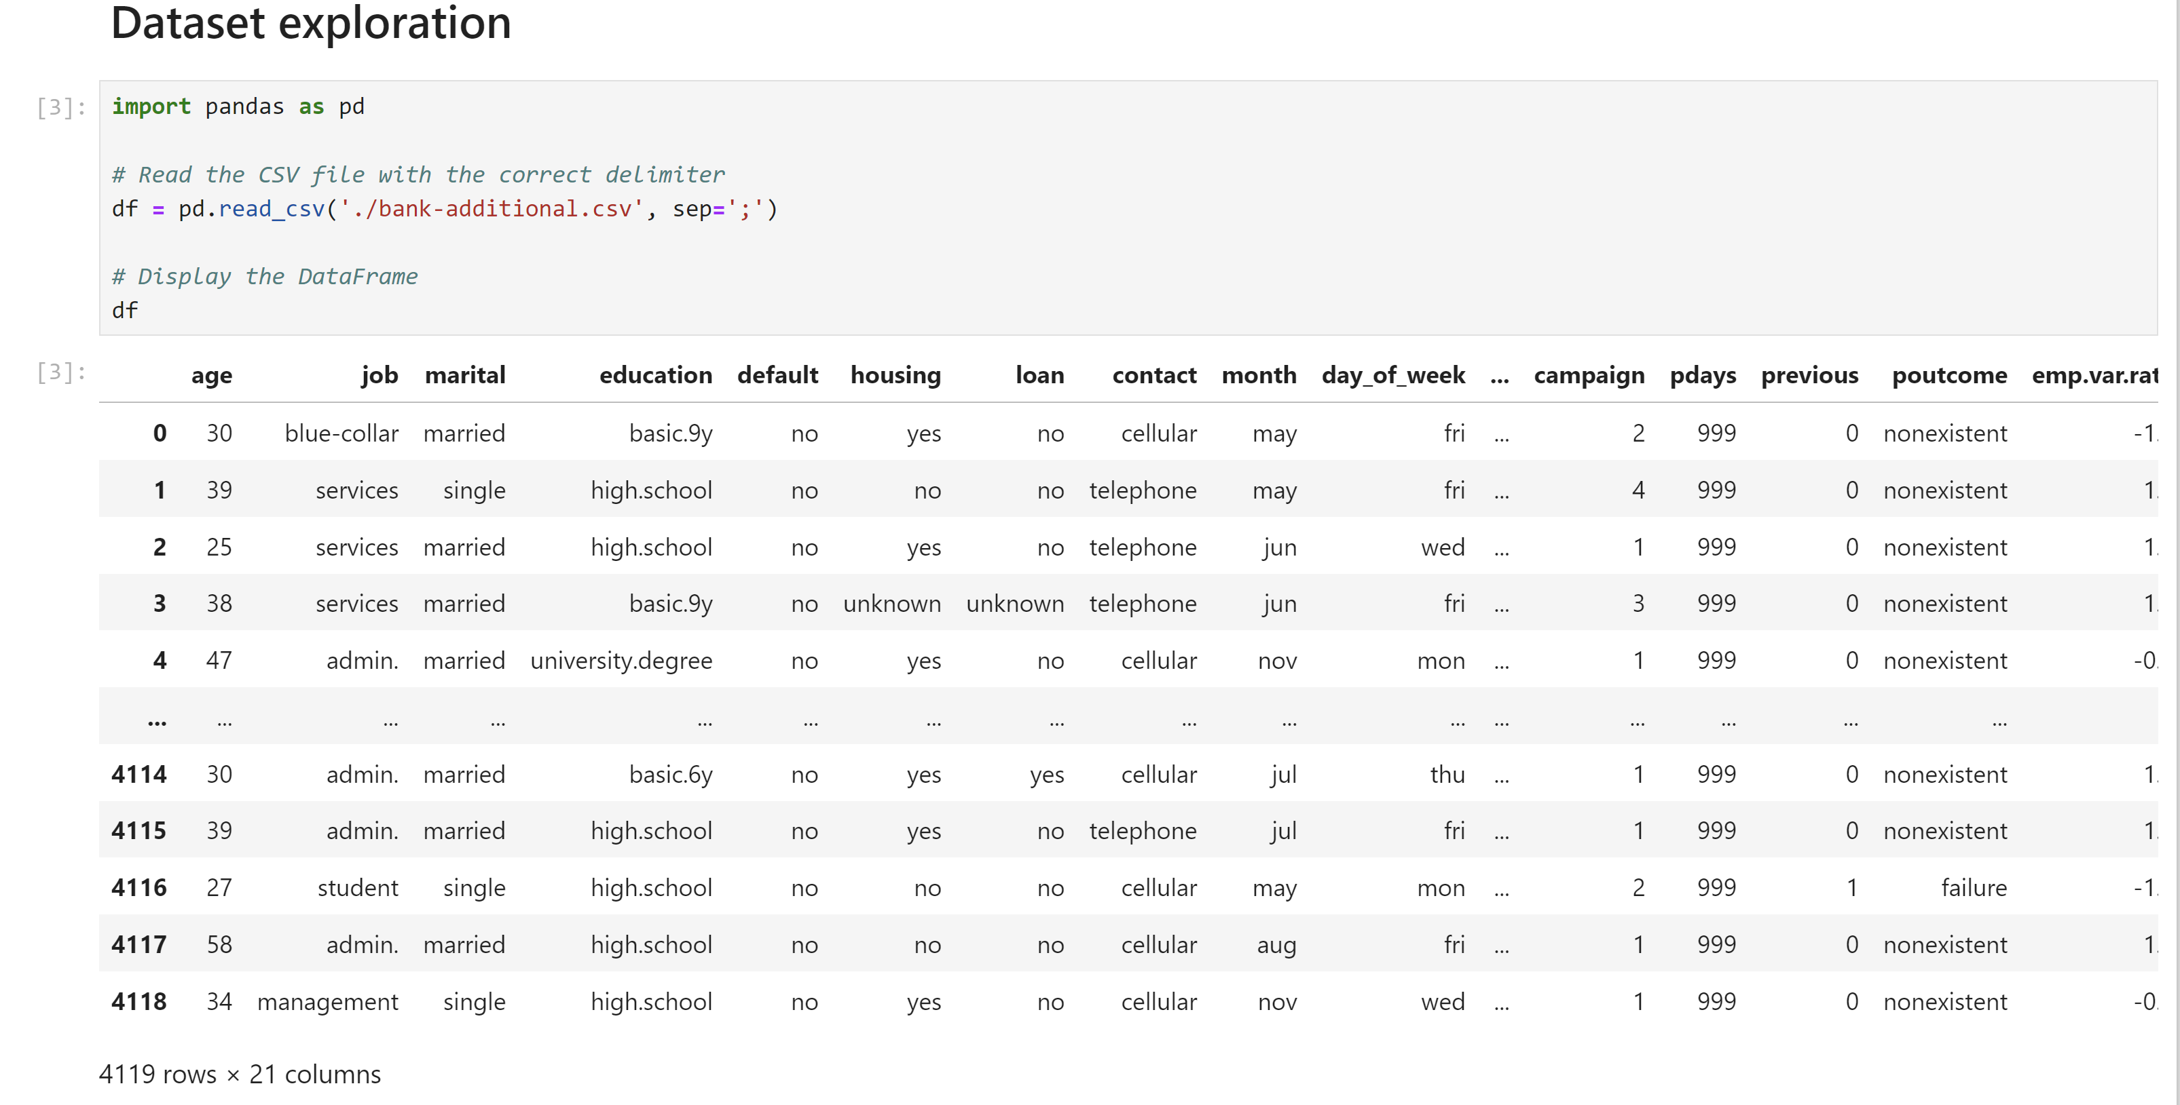
Step – 1) Install Matplotlib
Step 2) Import pandas,numpy& matplotib.pyplot
Step 3) Dataset Exploration

Slide 3
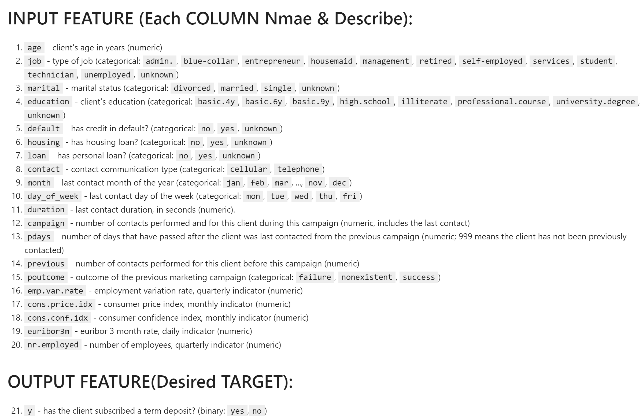

Slide 4
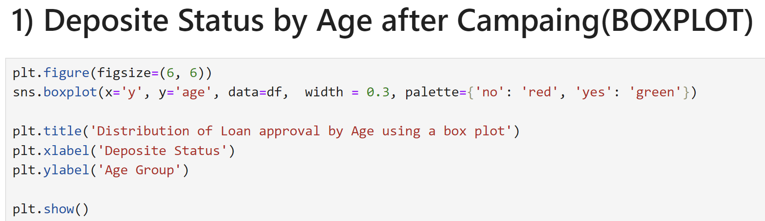
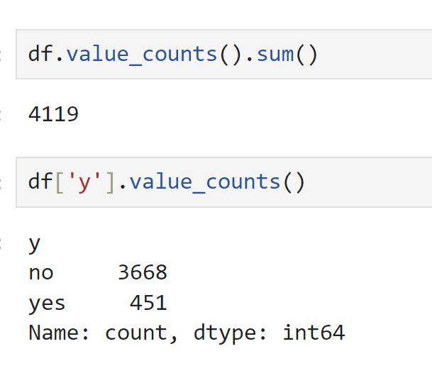
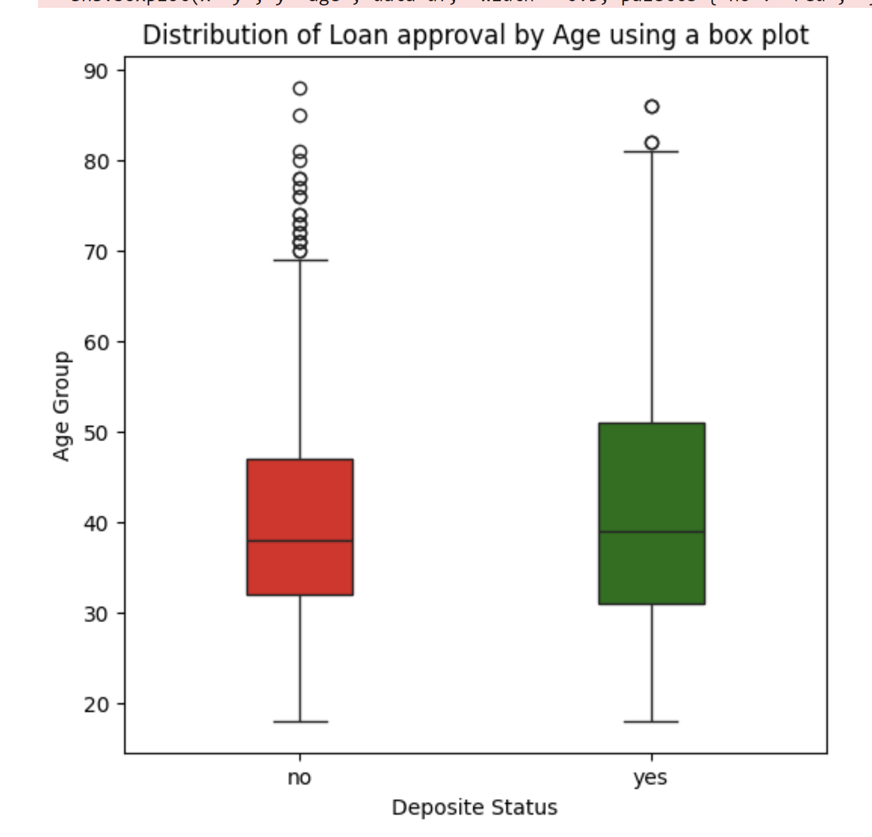
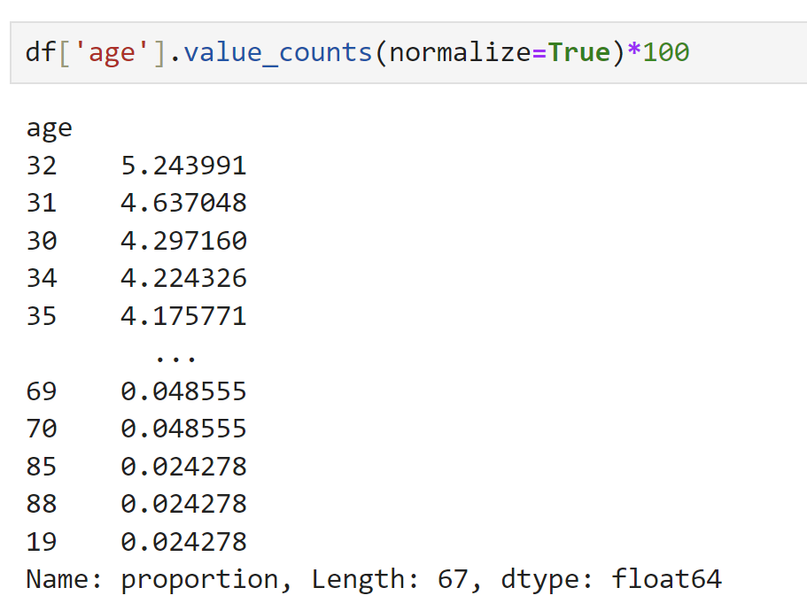
Entire Client Outreach for Campaign Invitation
OUTLIERS
INSIGHT
Age between 30 to near 60, they might to plan campaigns to deposit.
Total Deposited Clients
Deposited Client Age Group

Slide 5
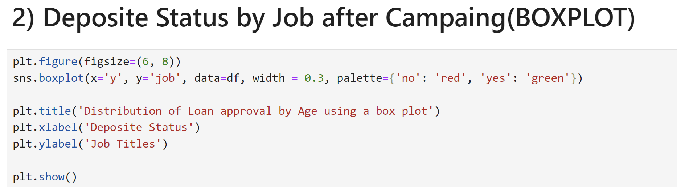
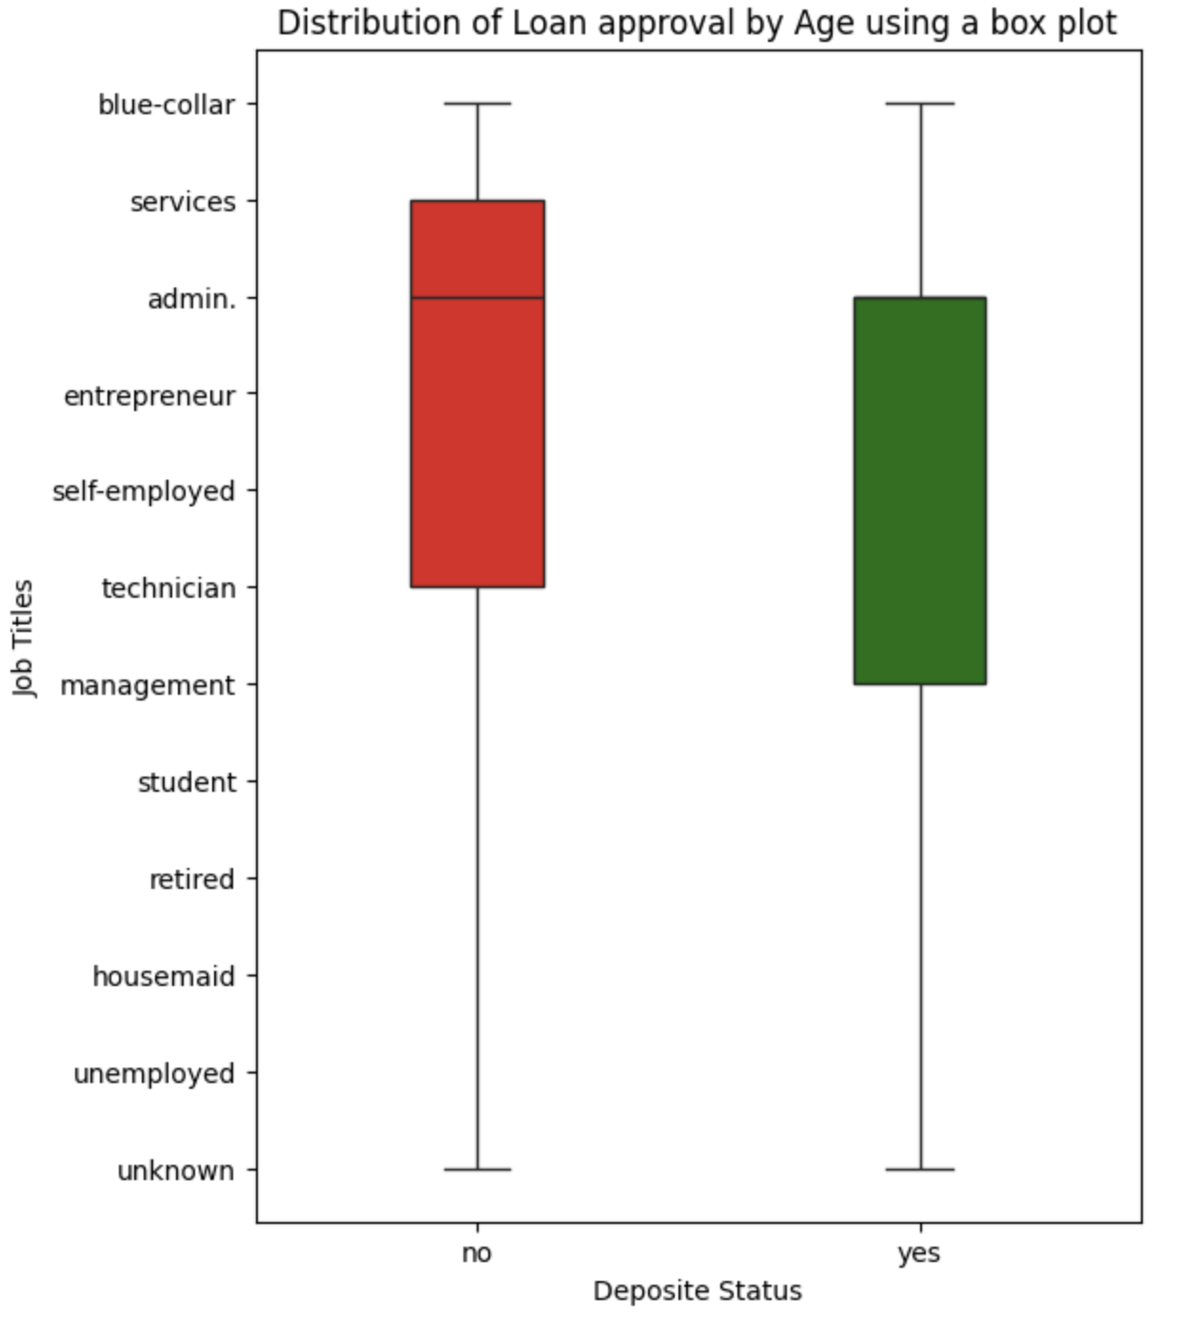
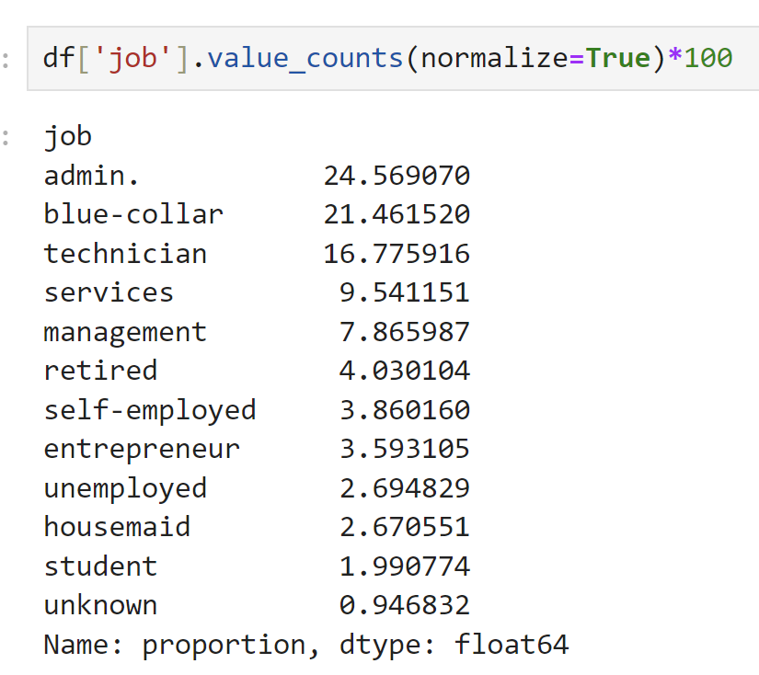
INSIGHT
Admin, blue-collar, Technical, Services, Management job types mostly deposited that time.
Entire Client Outreach for Campaign Invitation

Slide 6
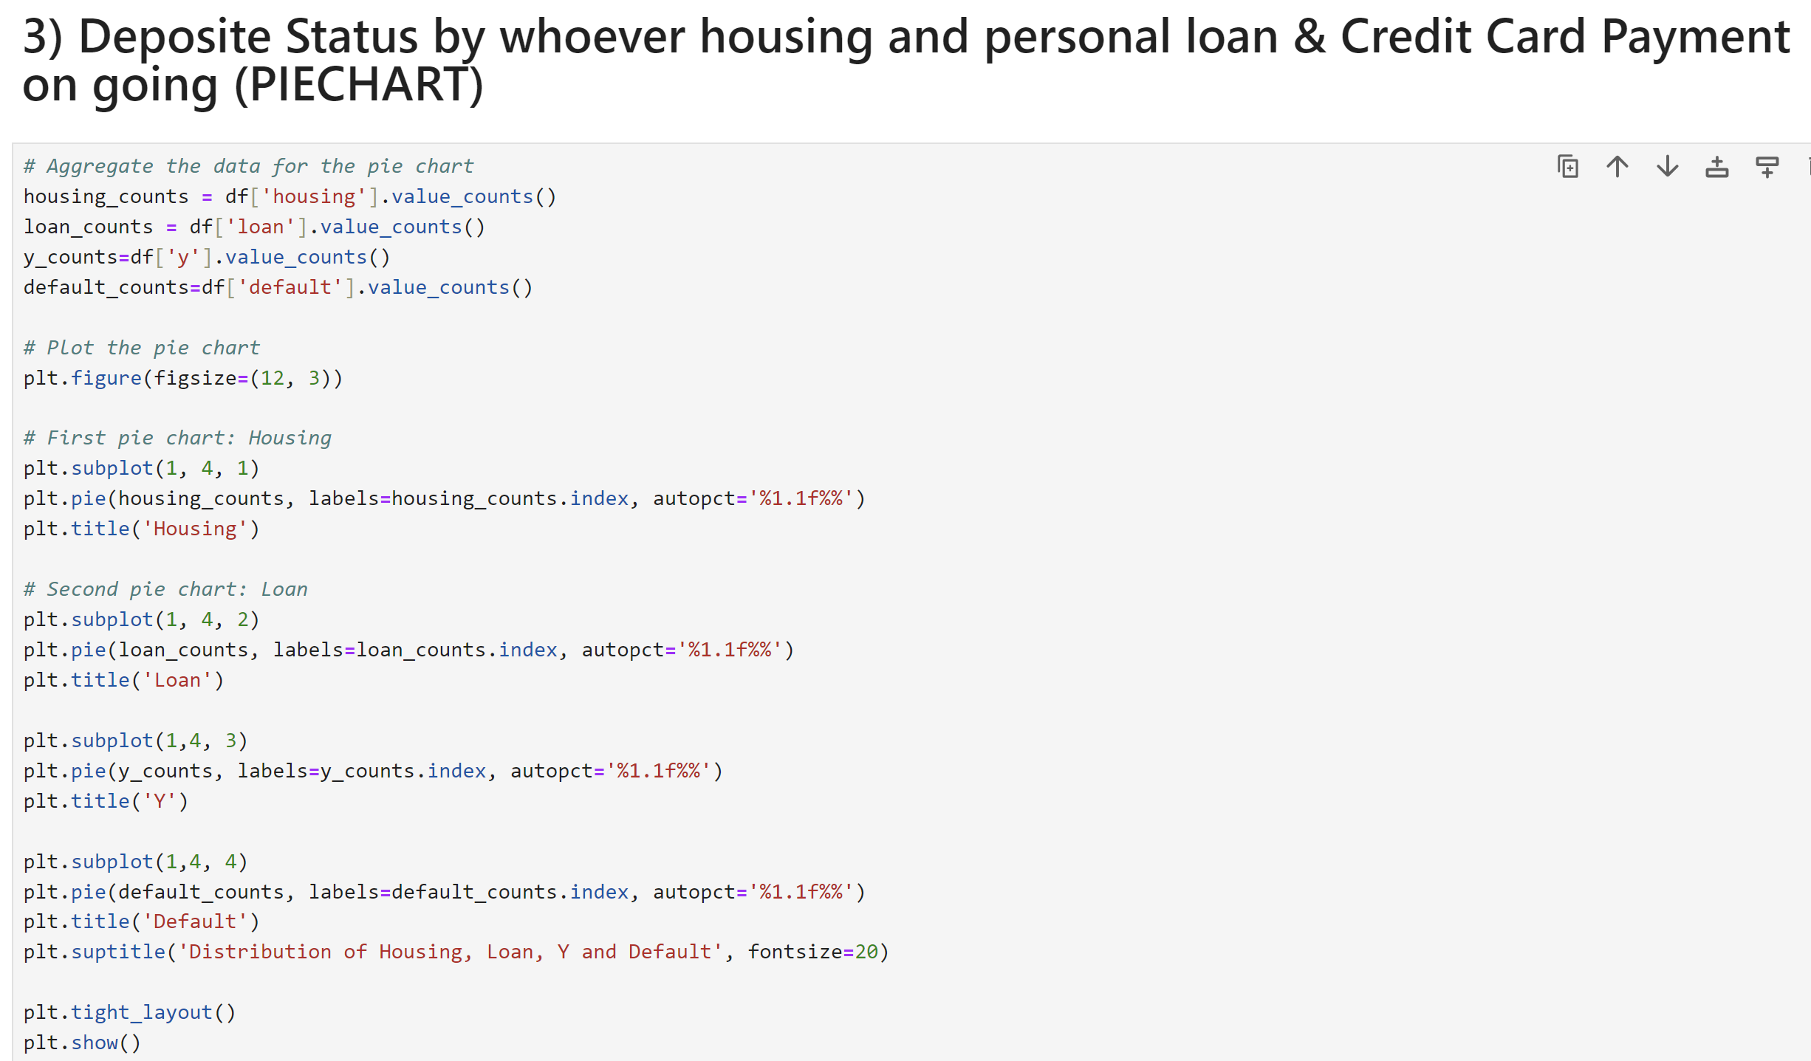
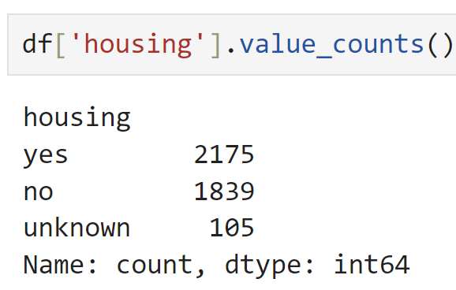
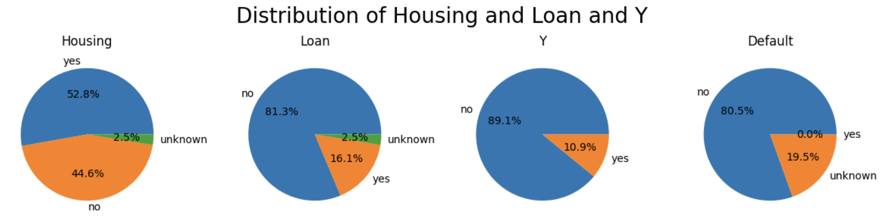
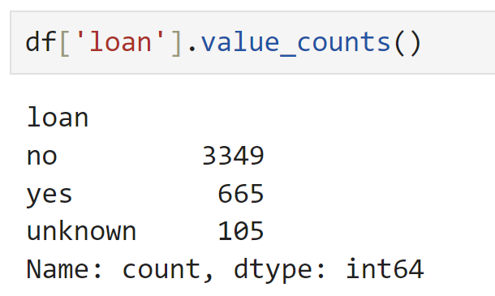
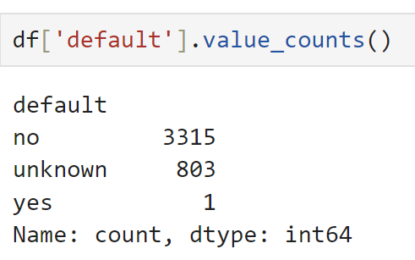
INSIGHT
HOUSING _ Campaing Clients mostly had house loan.
PERSONAL LOAN _ Most of the Clients were belonging Personal Loan.
Y _ A term deposit status (potential client or not)
DEFAULT _ Most of the clients are using Credit card and on going payments.

Slide 7
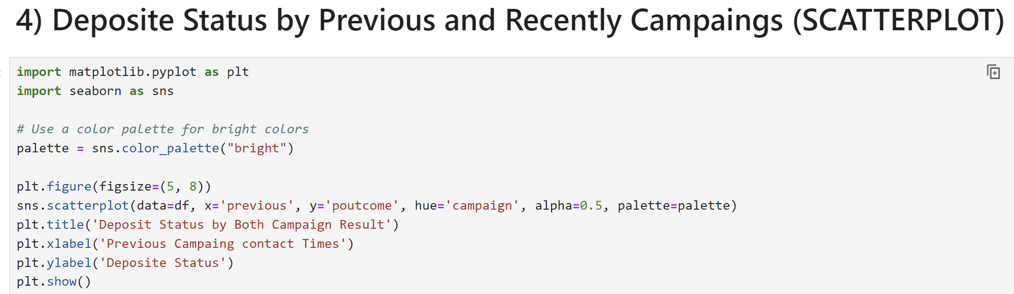
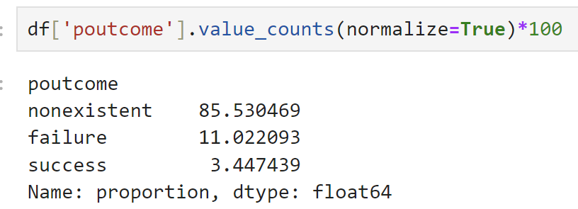
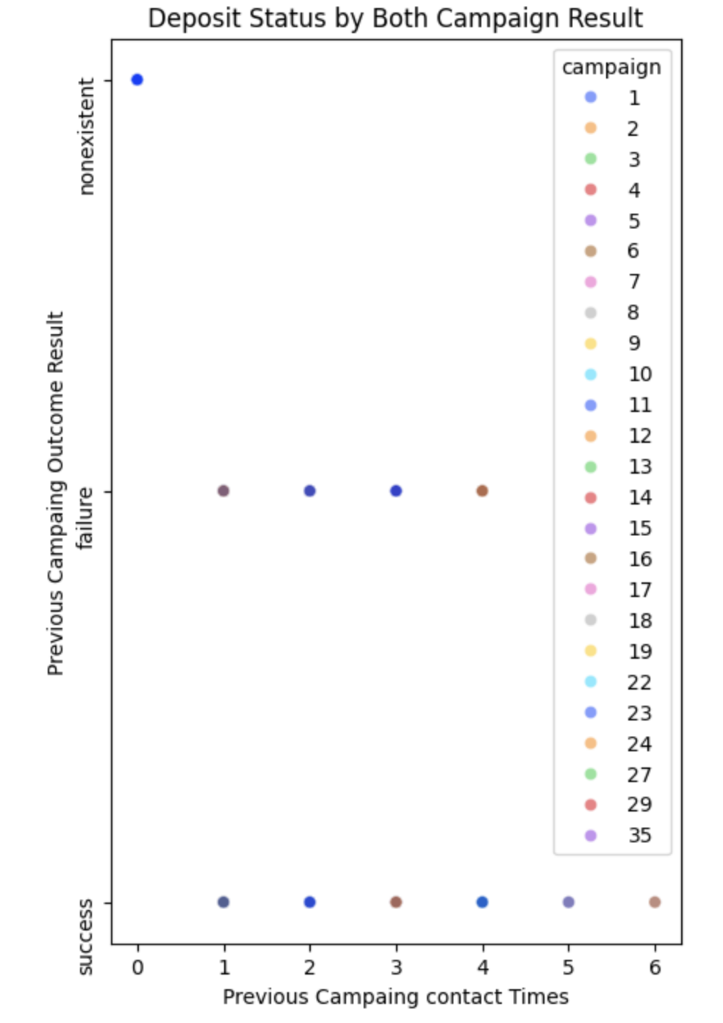
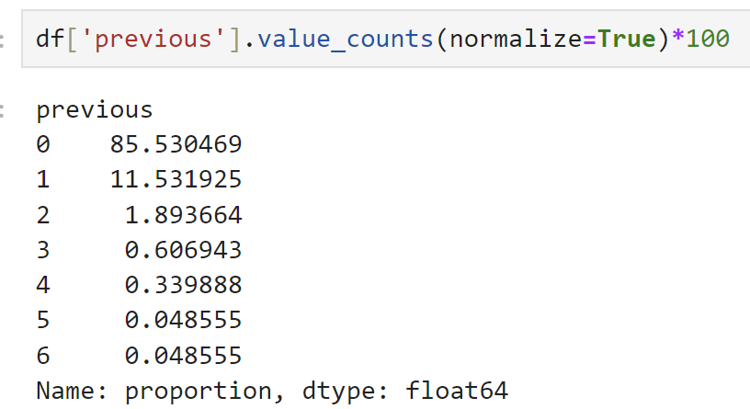
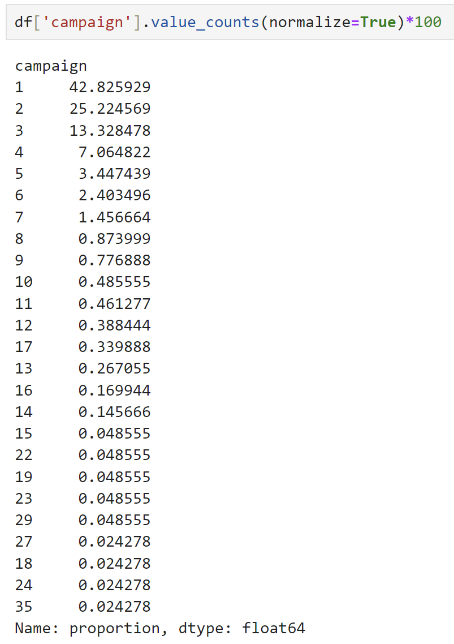
INSIGHT
1)Clients with no previous campaign outcome are rare or have little data.
2)There is a noticeable clustering of failure outcomes with a small number of previous contacts, suggesting that a small number of interactions are not always sufficient for a successful outcome.
3)Success is possible across a wider range of previous contact times, implying that consistent engagement might eventually lead to a positive outcome, even if not immediately.

Slide 8
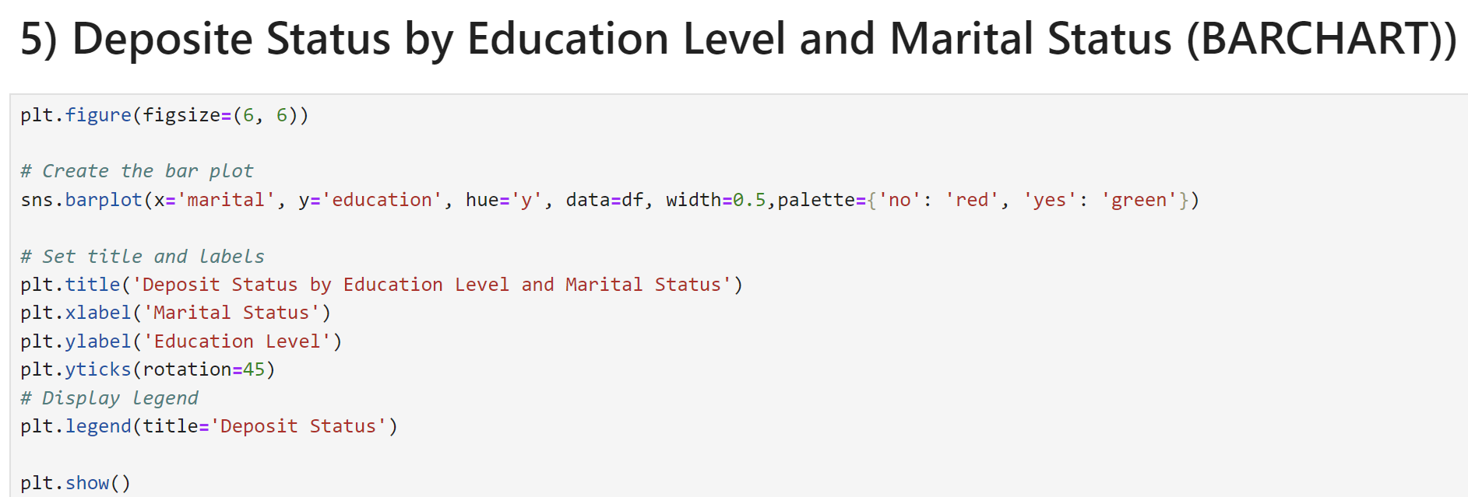
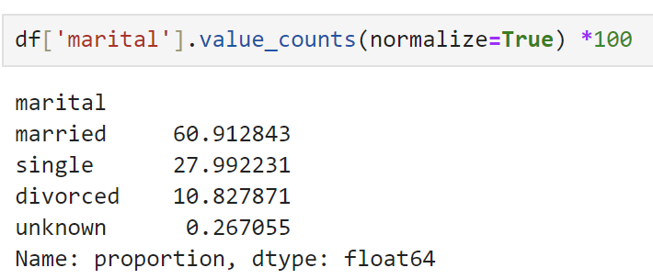
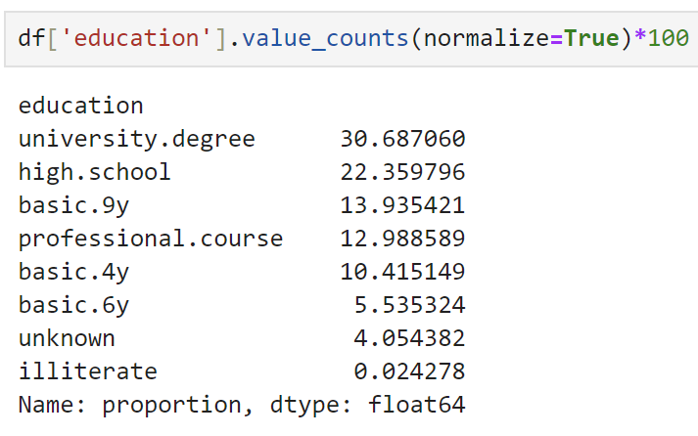
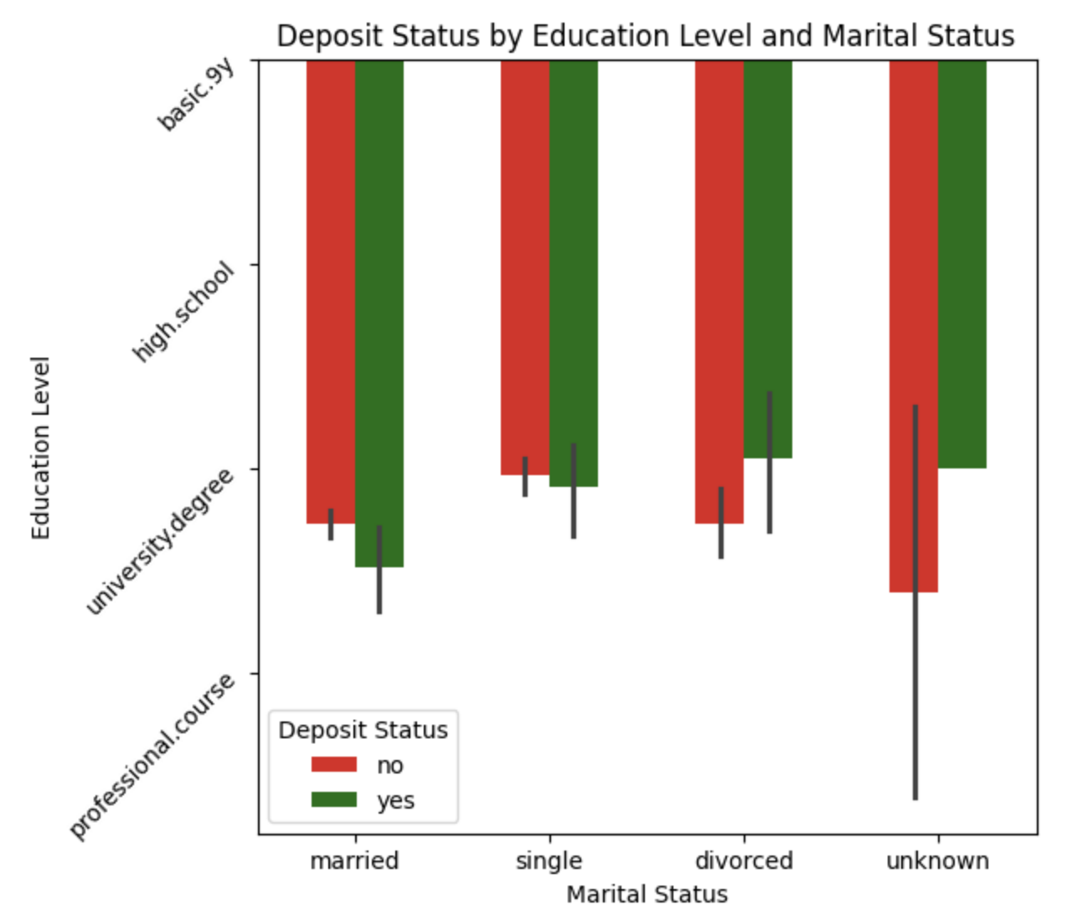
INSIGHT
Impact of Marital Status:
Married individuals generally show a higher tendency not to make a deposit. Single individuals are more likely to make deposits if they have a basic.9y or high school education.
Impact of Education Level:
University degree holders and professional course attendees, irrespective of their marital status, tend to show higher non-deposit rates. Those with basic.9y or high school education have more varied outcomes based on their marital status.
Unknown Marital Status:
The mixed pattern for individuals with unknown marital status suggests that other factors might be influencing their deposit decisions.

Slide 9
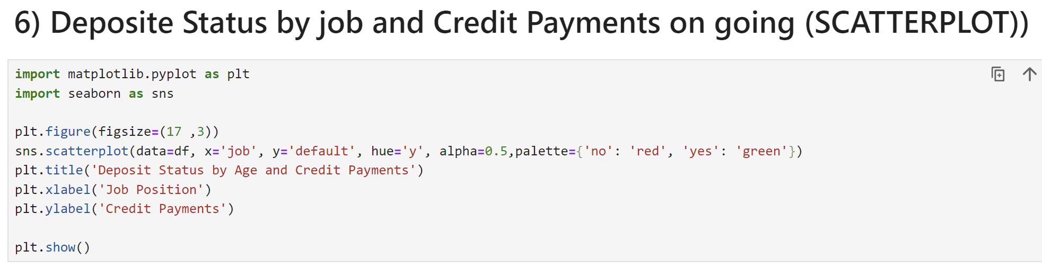
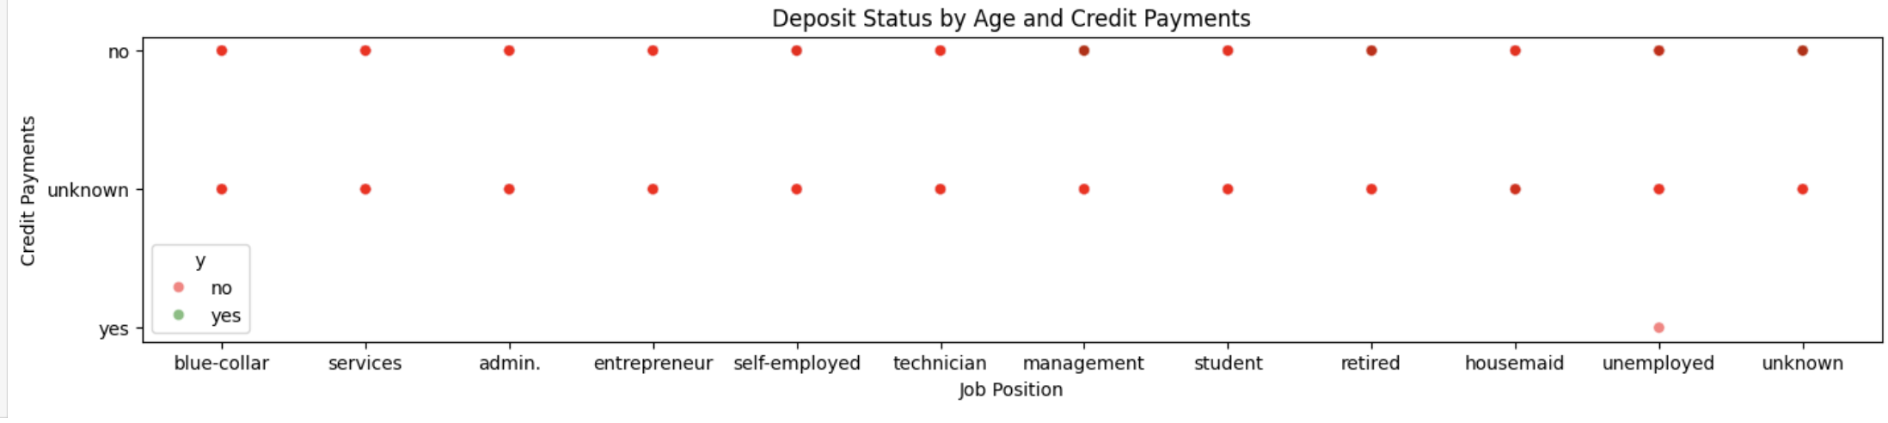
INSIGHT
Impact of Credit Payments:
The absence of green data points in both the "no" and "yes" credit payment categories suggests that individuals with credit payments, regardless of the status, are not making deposits.
Job Position Influence:
Job position does not seem to have a significant influence on deposit status when considering credit payment status, as all job positions show similar patterns.
Focus on Unknown Credit Payment Status:
The "unknown" credit payment category should be investigated further to understand why these individuals are not making deposits.

Slide 10
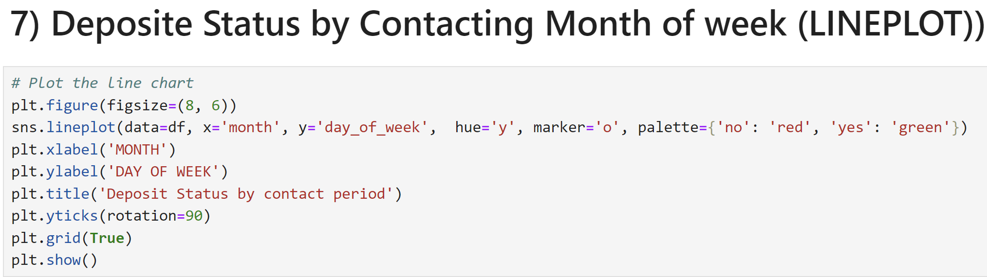
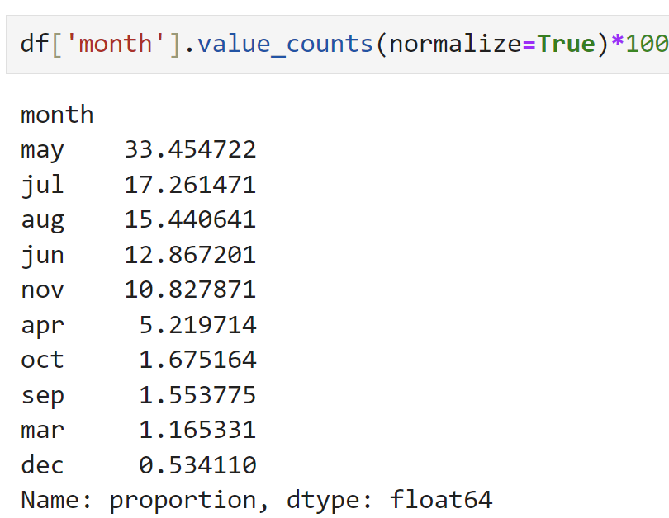
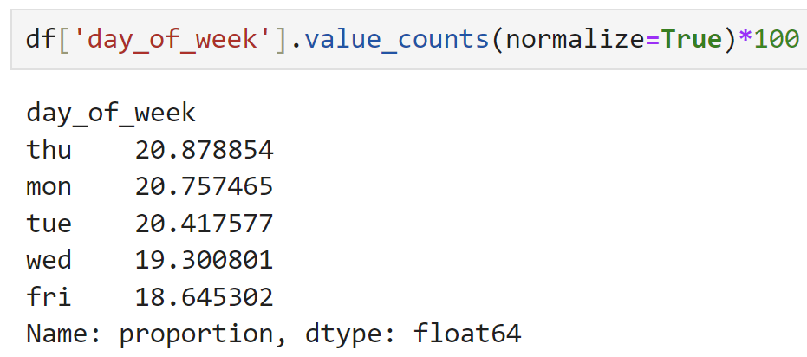
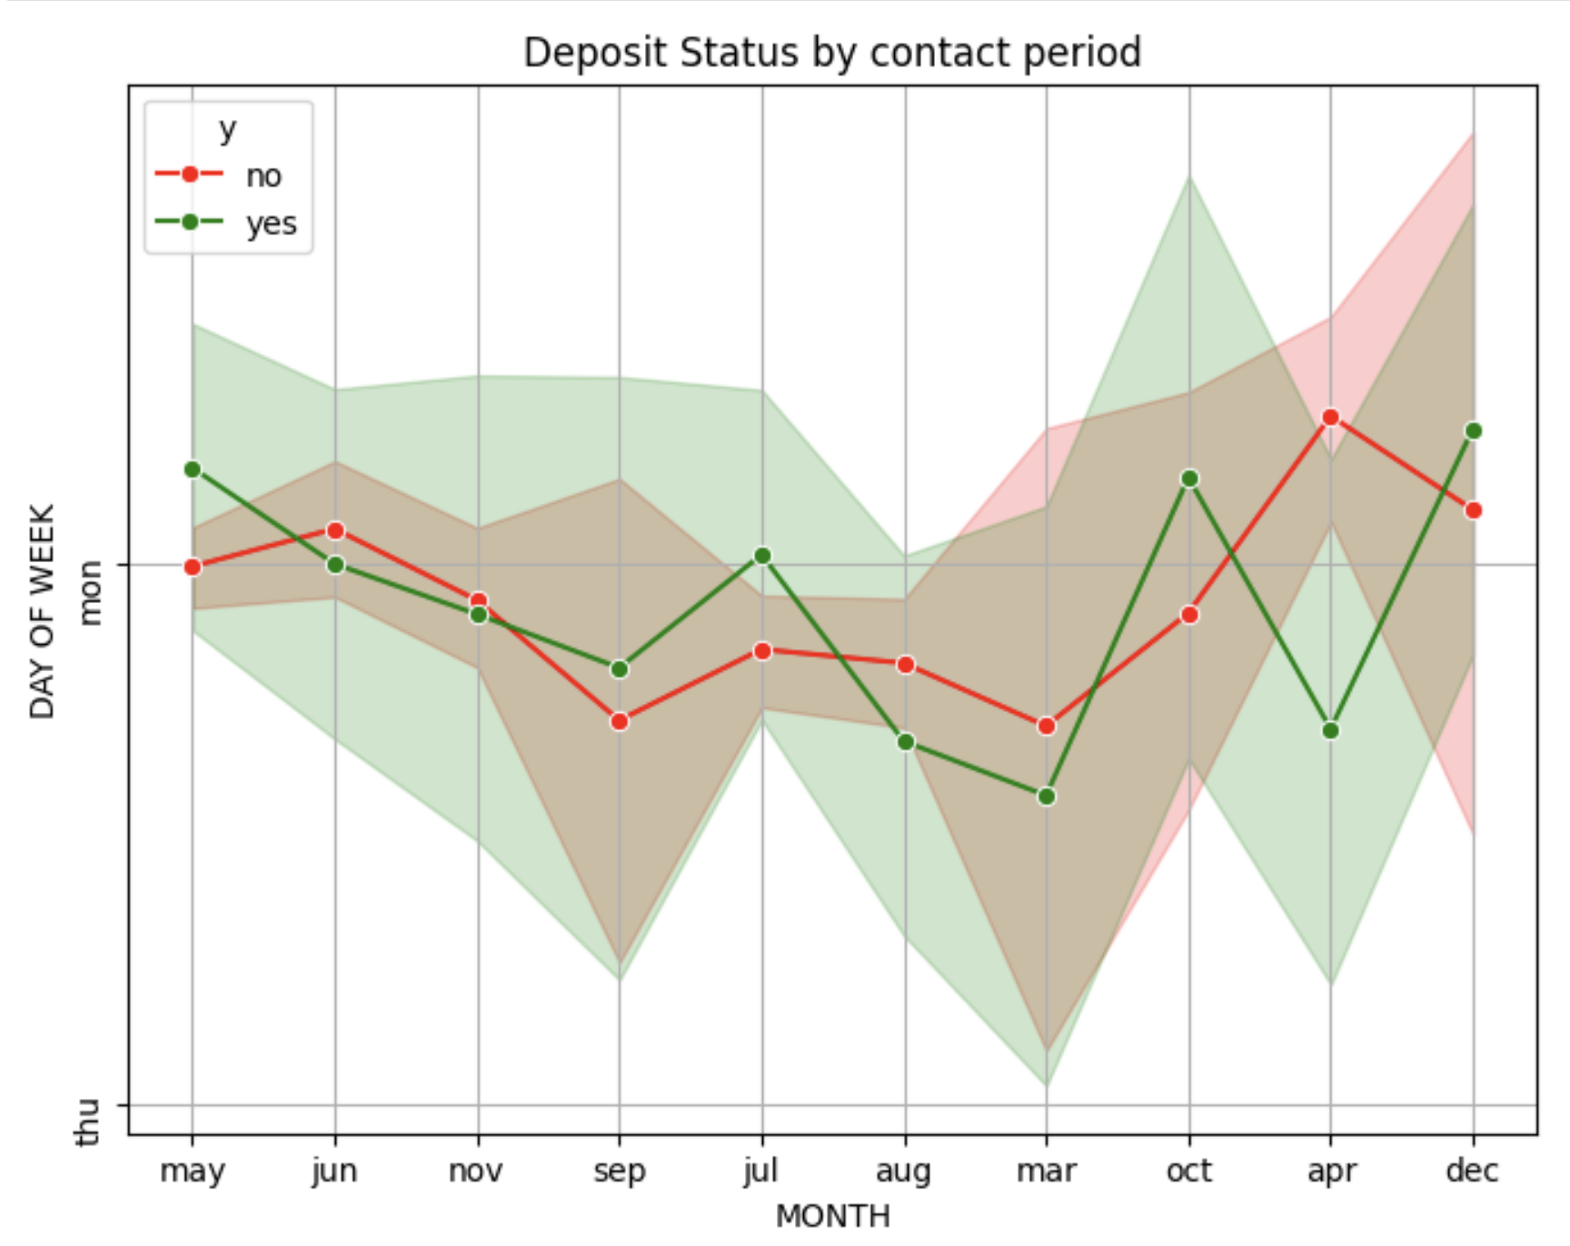
INSIGHT
Campaign Timing:
Focus on the months of May and October for campaigns, as these months show higher deposit rates.
Consider investigating why there is a decline in deposits from June to September and address potential issues.
Day of the Week Strategy:
Since the day of the week does not show a significant difference, campaigns can be uniformly distributed across the week.
Seasonal Analysis:
Further analysis could be done to understand the reasons behind the seasonal trends and optimize campaign strategies accordingly.

Slide 11
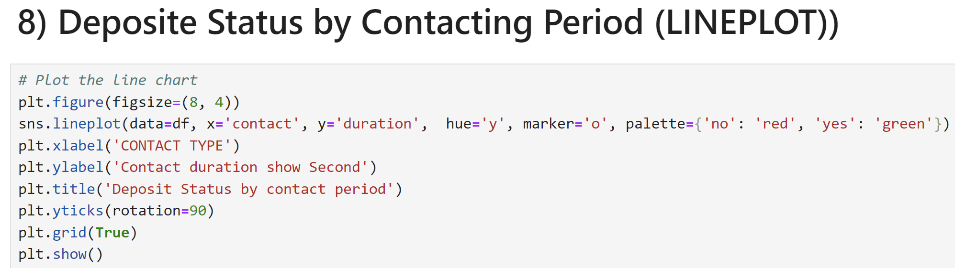
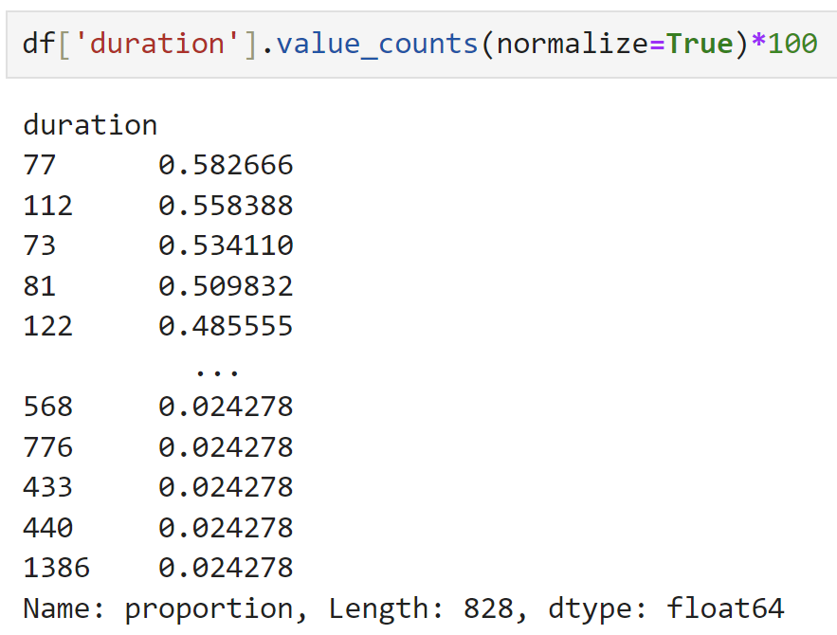
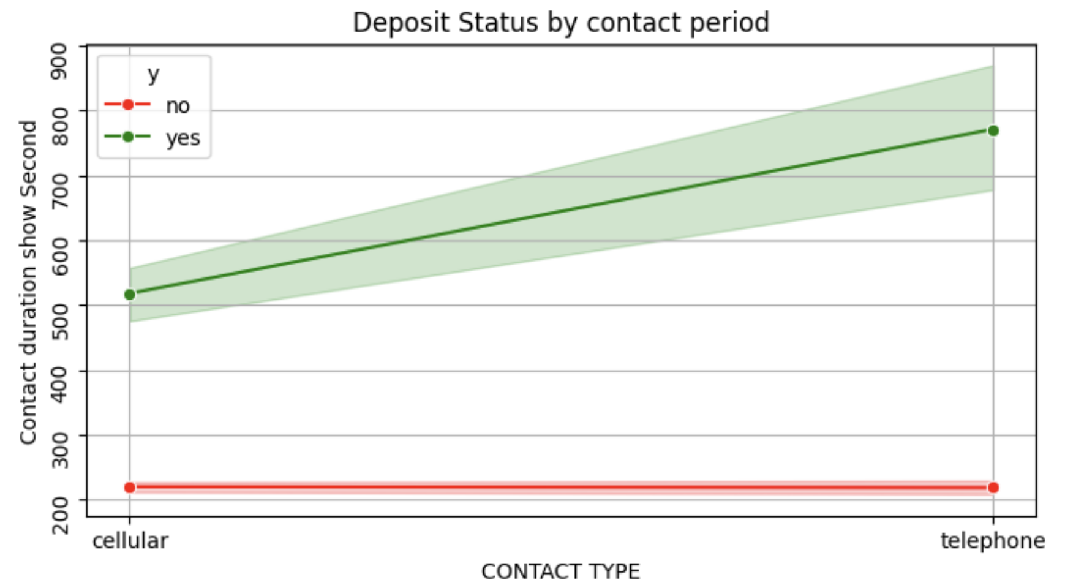
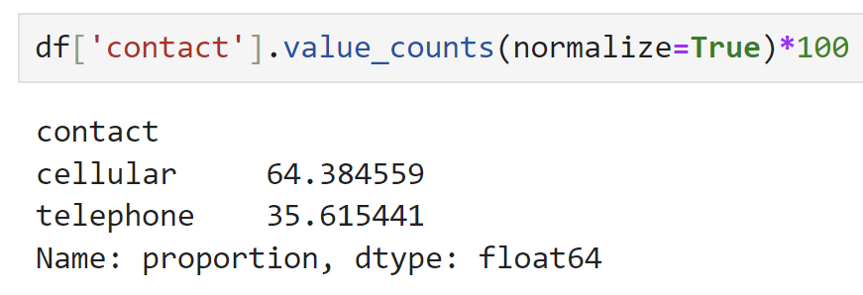
INSIGHT
The graph hints that longer telephone calls may lead to more successful deposits. However, further analysis would require additional context or data.

Slide 12
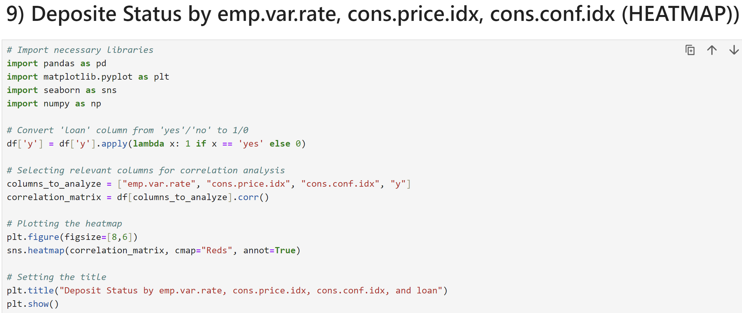
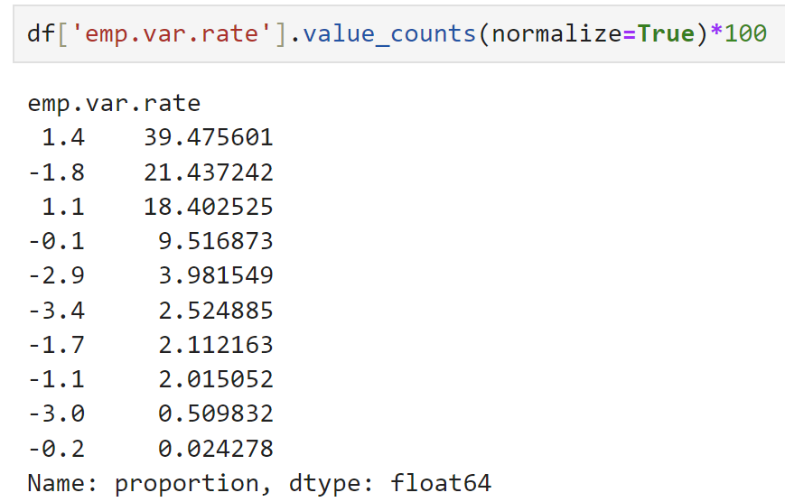
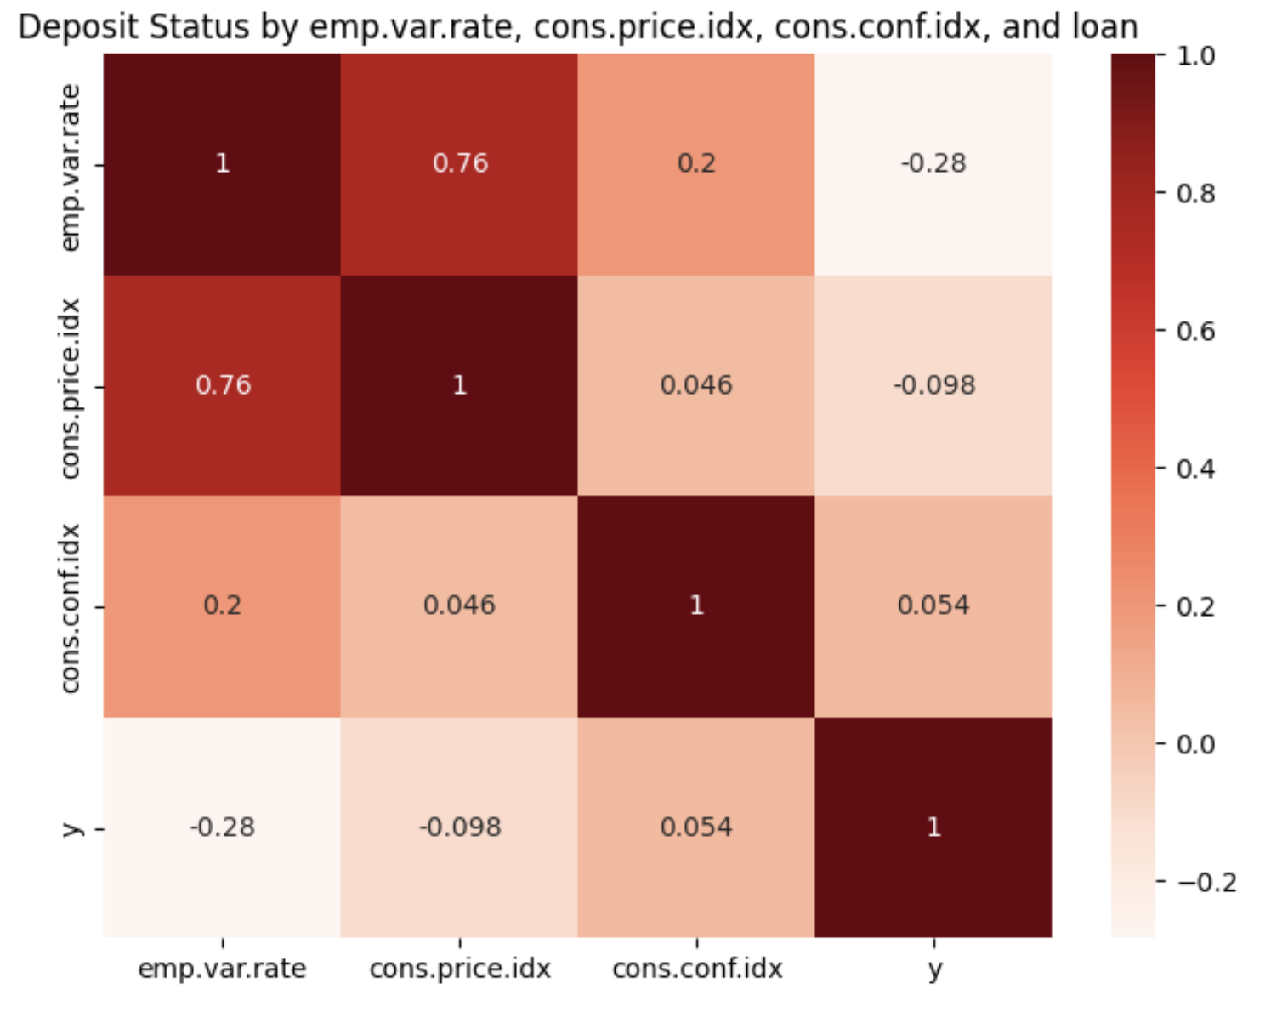
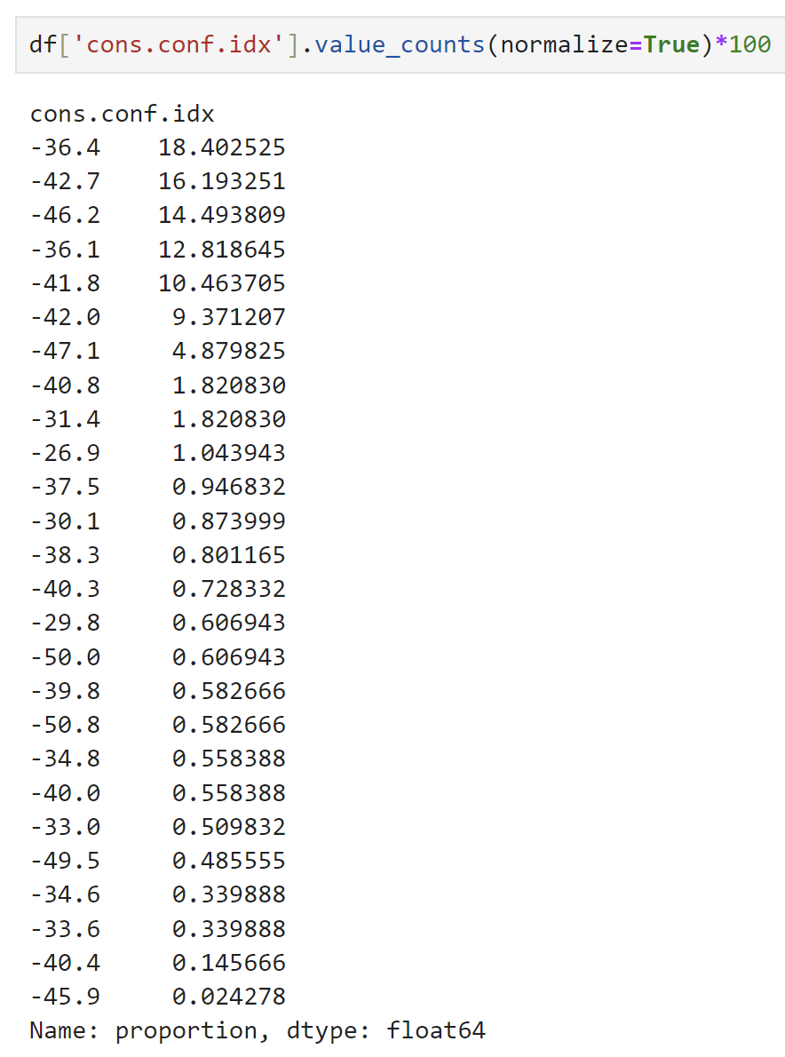
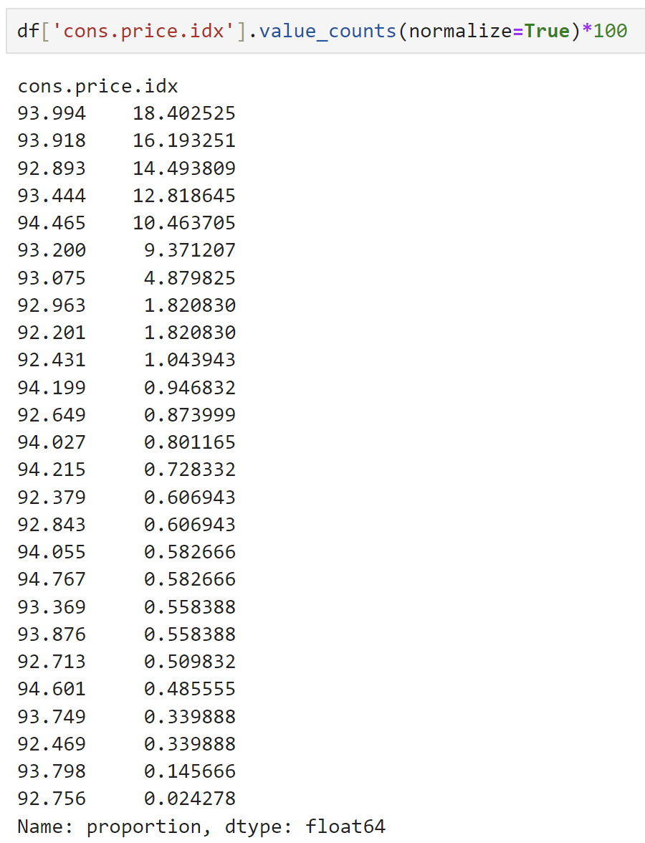
INSIGHT
The highest correlation observed is between `emp.var.rate` and `cons.price.idx` (0.76), indicating a significant relationship between these economic indicators.
Other variables (`emp.var.rate` and `y`) show very weak or negligible correlations with each other and with `emp.var.rate` and `cons.price.idx`, suggesting that these factors are not strongly interdependent in the given dataset.

Slide 13
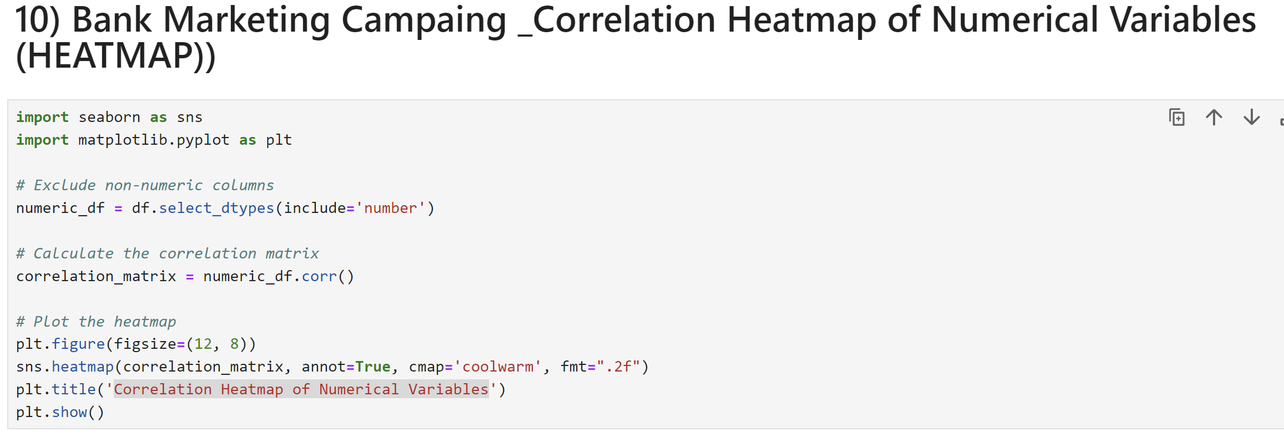
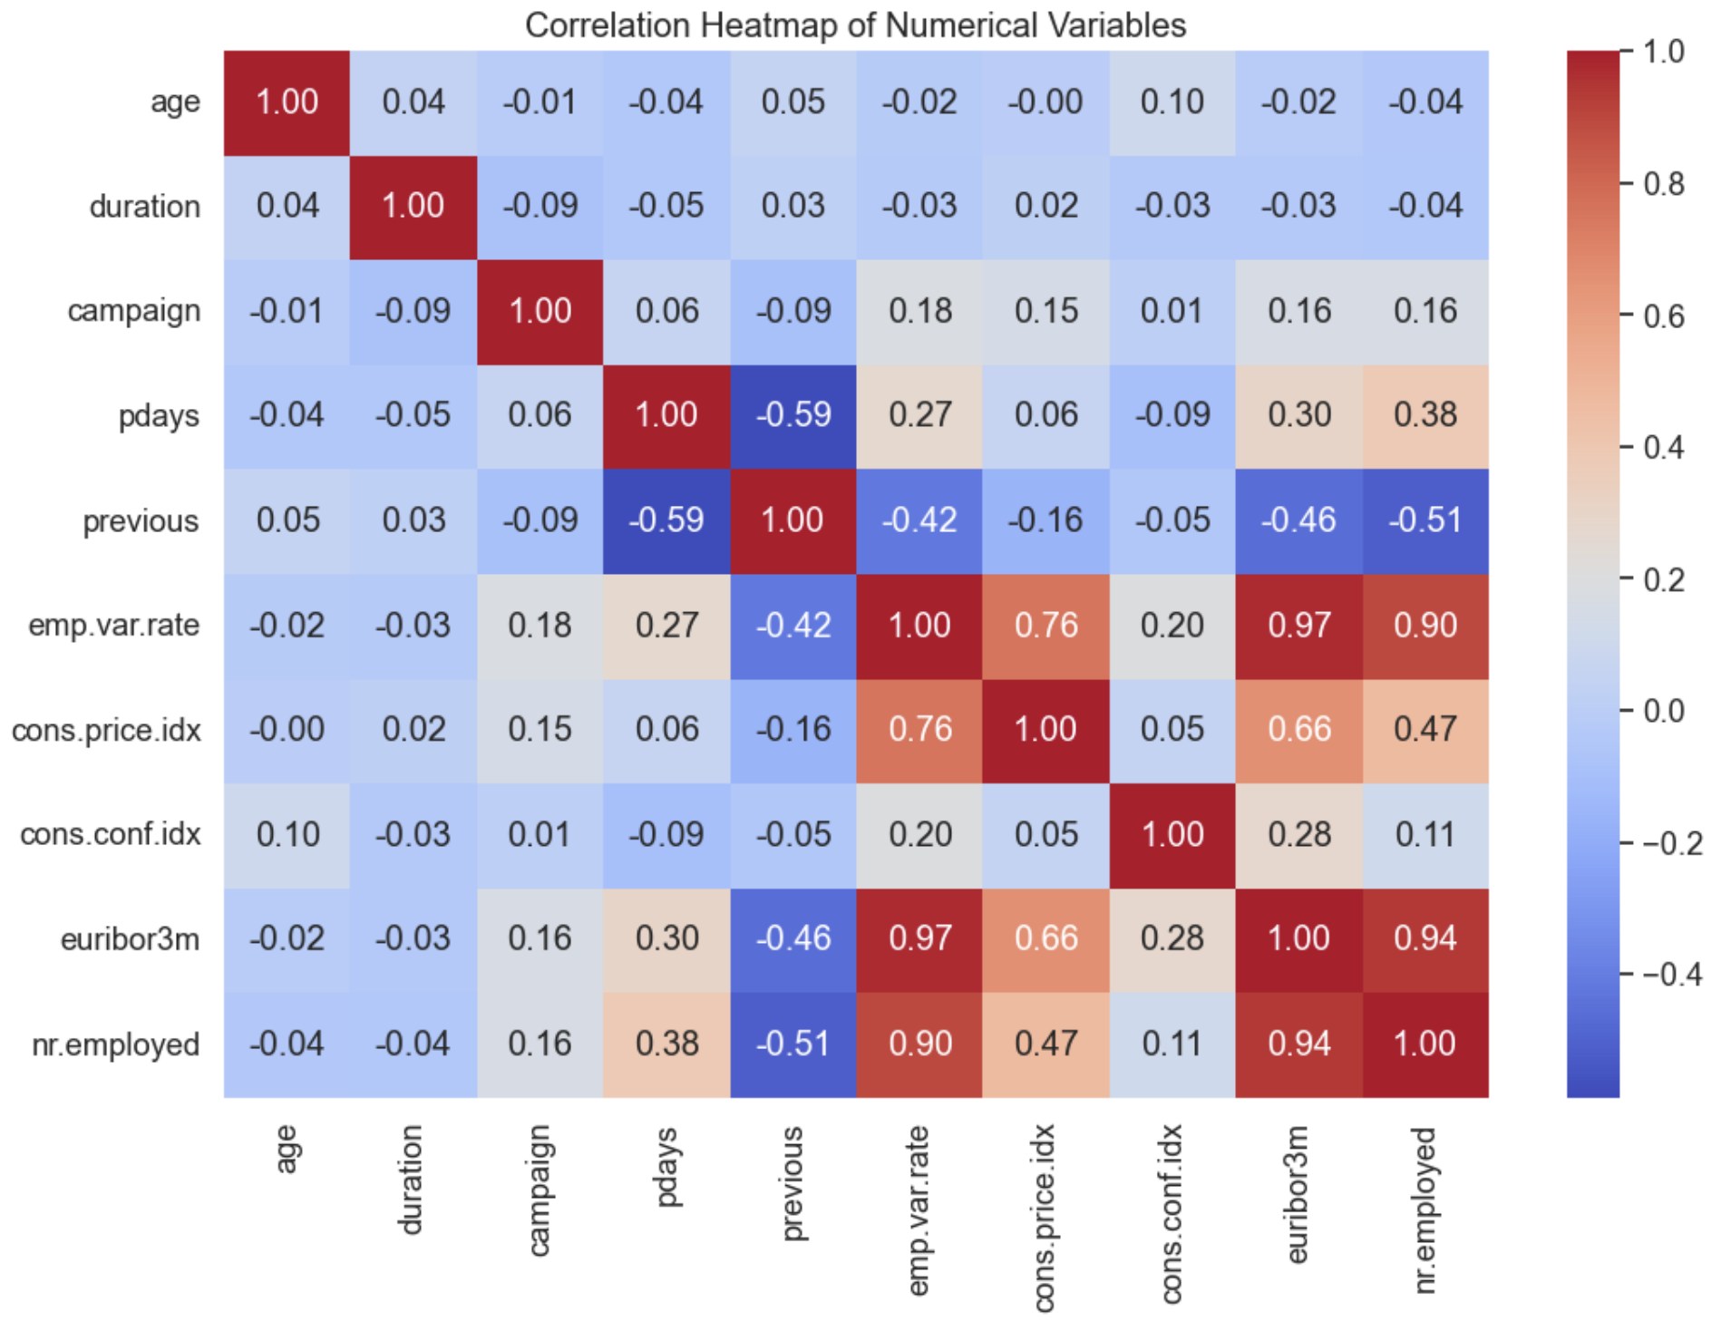
This was provided a correlation heatmap of numerical variables
1. Positive Correlations:
Variables like ‘emp.var.rate’ and ‘euribor3m’ exhibit a strong positive correlation (indicated by the dark red square). This suggests that these two variables tend to move together in the same direction.
Similarly, ‘duration’ and ‘previous’ have a positive correlation.
Negative Correlations:
‘emp.var.rate’ and ‘cons.price.idx’ show a strong negative correlation (dark blue color).
‘pdays’ and ‘previous’ also have a negative correlation.
No Correlation:
Variables along the diagonal (e.g., ‘age,’ ‘duration’) have no correlation with themselves (white squares).
This heatmap helps identify relationships between variables.

Slide 14


MEET OUR TEAM
Khin Yandar Hlaing
THIRI WHAR WHAR LWIN
STUDENT​
STUDENT
THANK YOU

